Slide 1
UNSW-NB15
Identifying Malicious Traffic

Slide 2
Data Prep
Dropping unneeded fields
Attack Category
ID
Make string categoricals into integers
Separate out categorical and numeric data
Transform text based categorical data to numeric

Slide 3
Pipelines
Two main pipeline types set up:
Preprocessor pipeline
transforms the numerical data using an imputer for missing data and a scaler for bringing the data to the same scale
transforms the categorical data (that we changed to numerical values) by expanding the data into a binary format
Training pipeline - uses the preprocessor pipeline and then appends the model pipeline for training the model and then testing the accuracy

Slide 4
Models
Logistic Regression model train score: 0.935
Logistic Regression model test score: 0.798
SVC model train score: 0.935
SVC model test score: 0.558
Decision Tree model train score: 0.951
Decision Tree model test score: 0.844
Stochastic Gradient Descent model train score: 0.934
Stochastic Gradient Descent model test score: 0.782

Slide 5
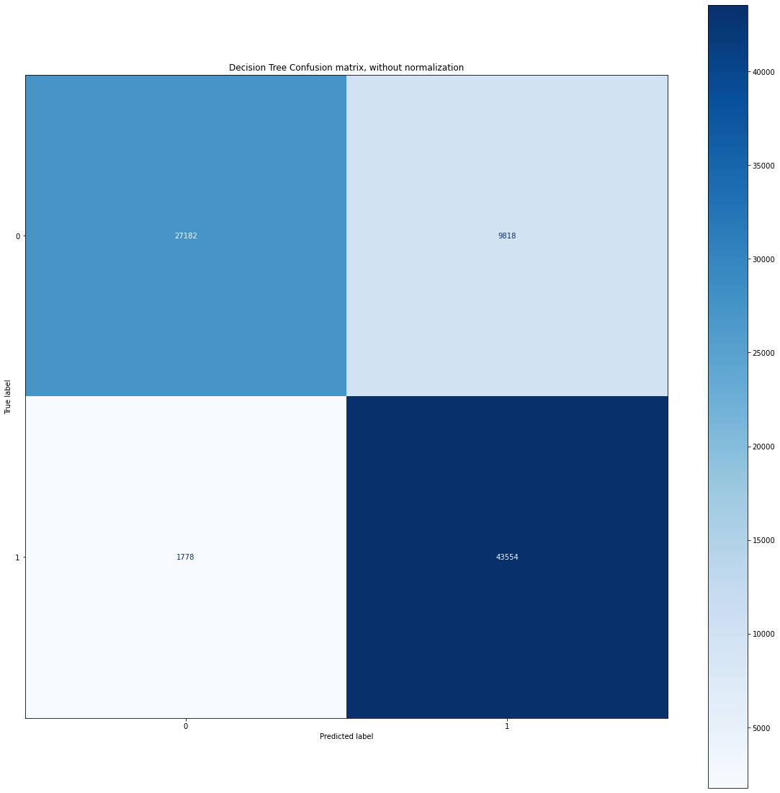
Decision Tree - Starting Point
Scores
Train score: 0.951
Test score: 0.844
No Modification to parameters

Slide 6
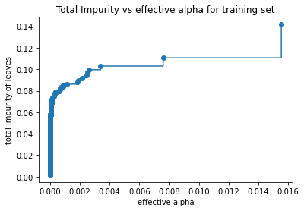
Alpha tuning
Tried to find optimal ccp_alpha
Was already pretty efficient
Number of nodes in the tree and depth of the tree decreases as α increases
Iterated over all α’s identified
Accuracy lost stability and accuracy dropped off around an α of .00073777
Model generalizes well, only a 2% gain from alpha hat

Slide 7
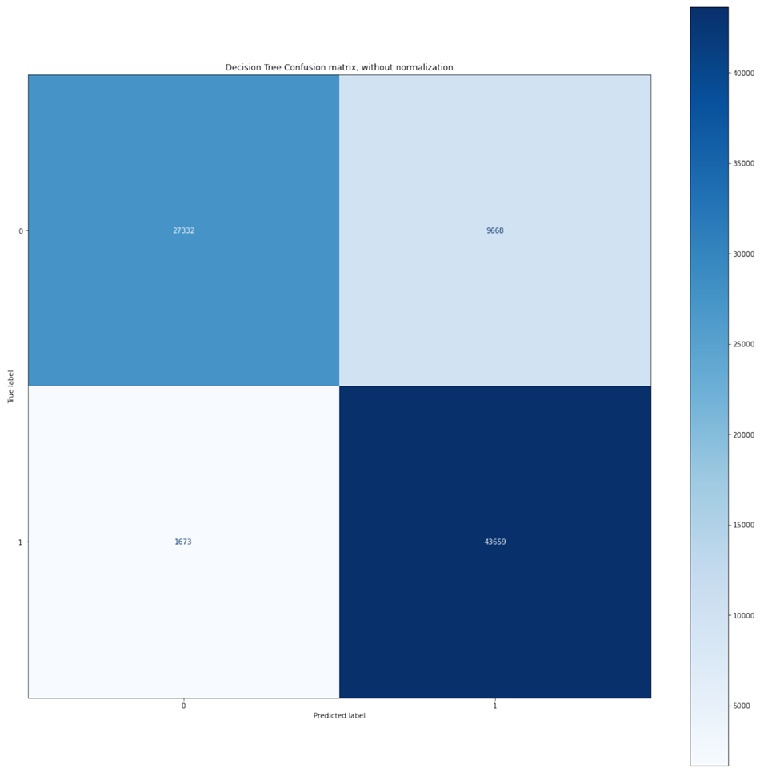
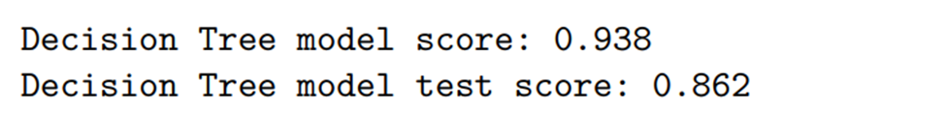
Final Result after Cost Complexity Parameter Pruning

Slide 8
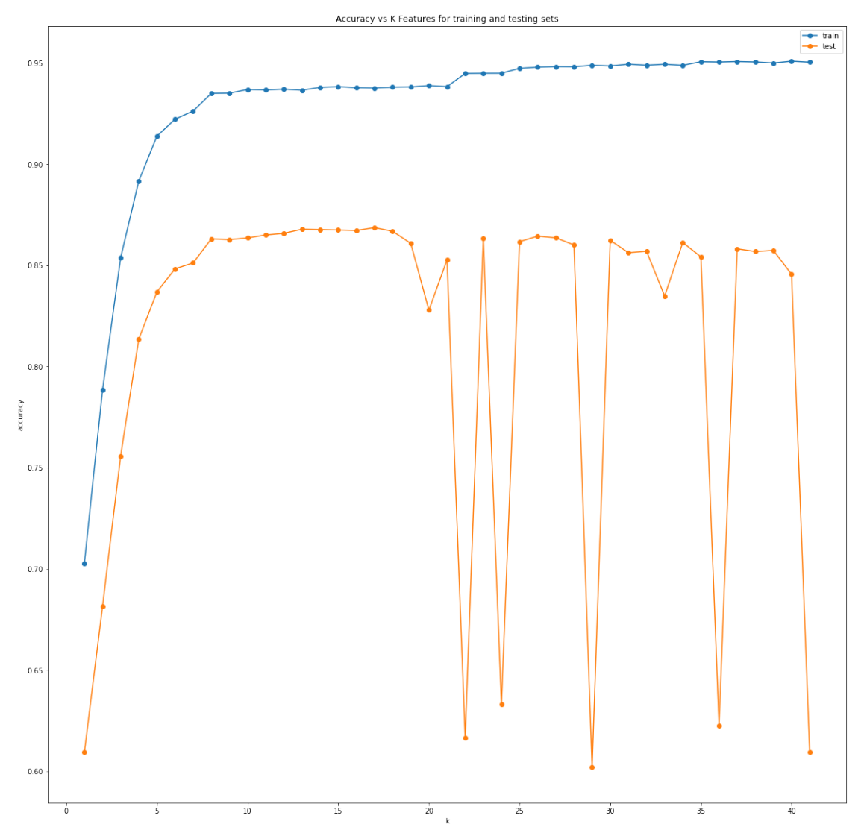
Feature Selection
SelectKBest found limited improvements
Would be more important in real time use case
Sweet spot around k=8 features

Slide 9
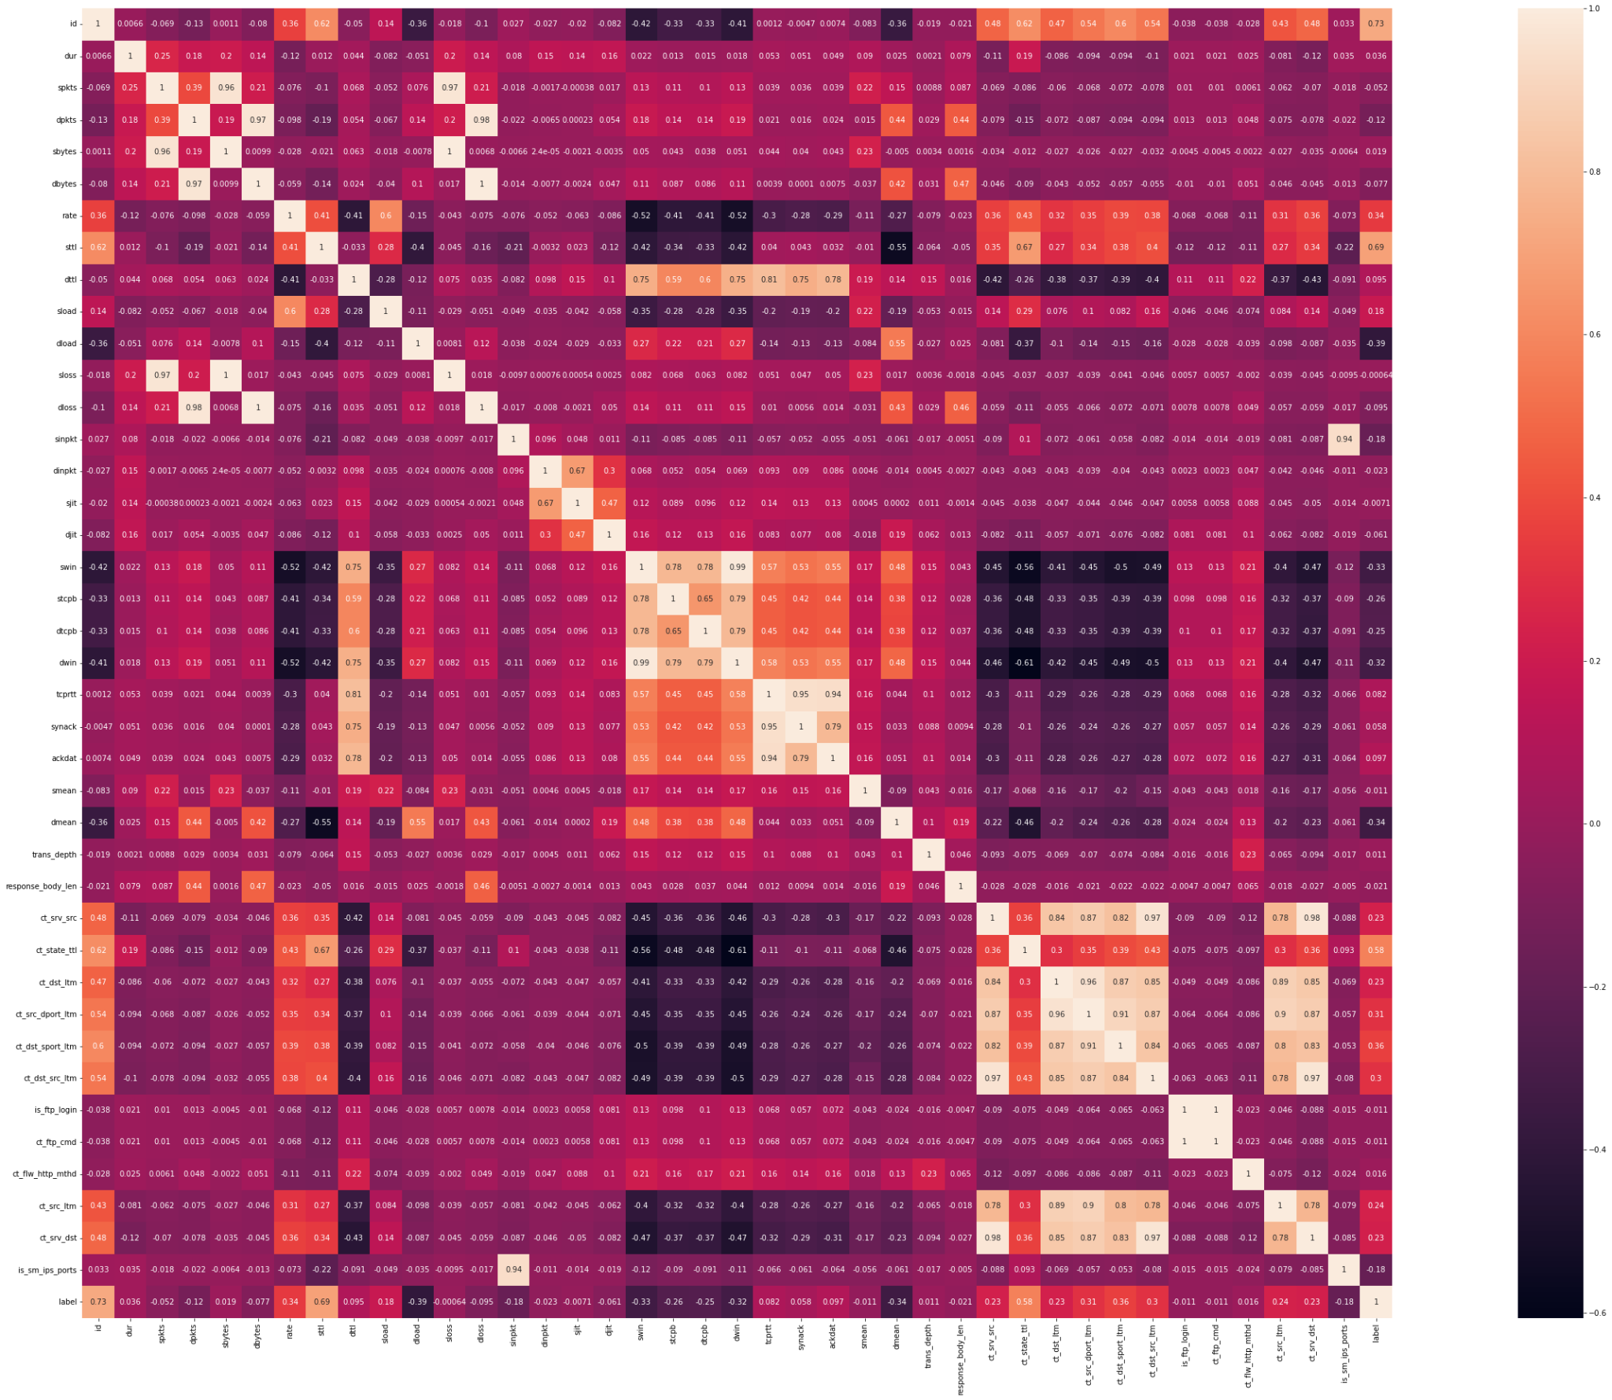
Correlation
Heatmap
Key Features
Meta Features
Loss
Bytes
Packets

Slide 10
Key Documentation
https://scikit-learn.org/stable/modules/generated/sklearn.pipeline.Pipeline.html
https://scikit-learn.org/stable/modules/generated/sklearn.metrics.ConfusionMatrixDisplay.html
https://seaborn.pydata.org/generated/seaborn.heatmap.html
https://scikit-learn.org/stable/auto_examples/tree/plot_cost_complexity_pruning.html
https://scikit-learn.org/stable/modules/generated/sklearn.tree.DecisionTreeClassifier.html#sklearn.tree.DecisionTreeClassifier

